Slide 1
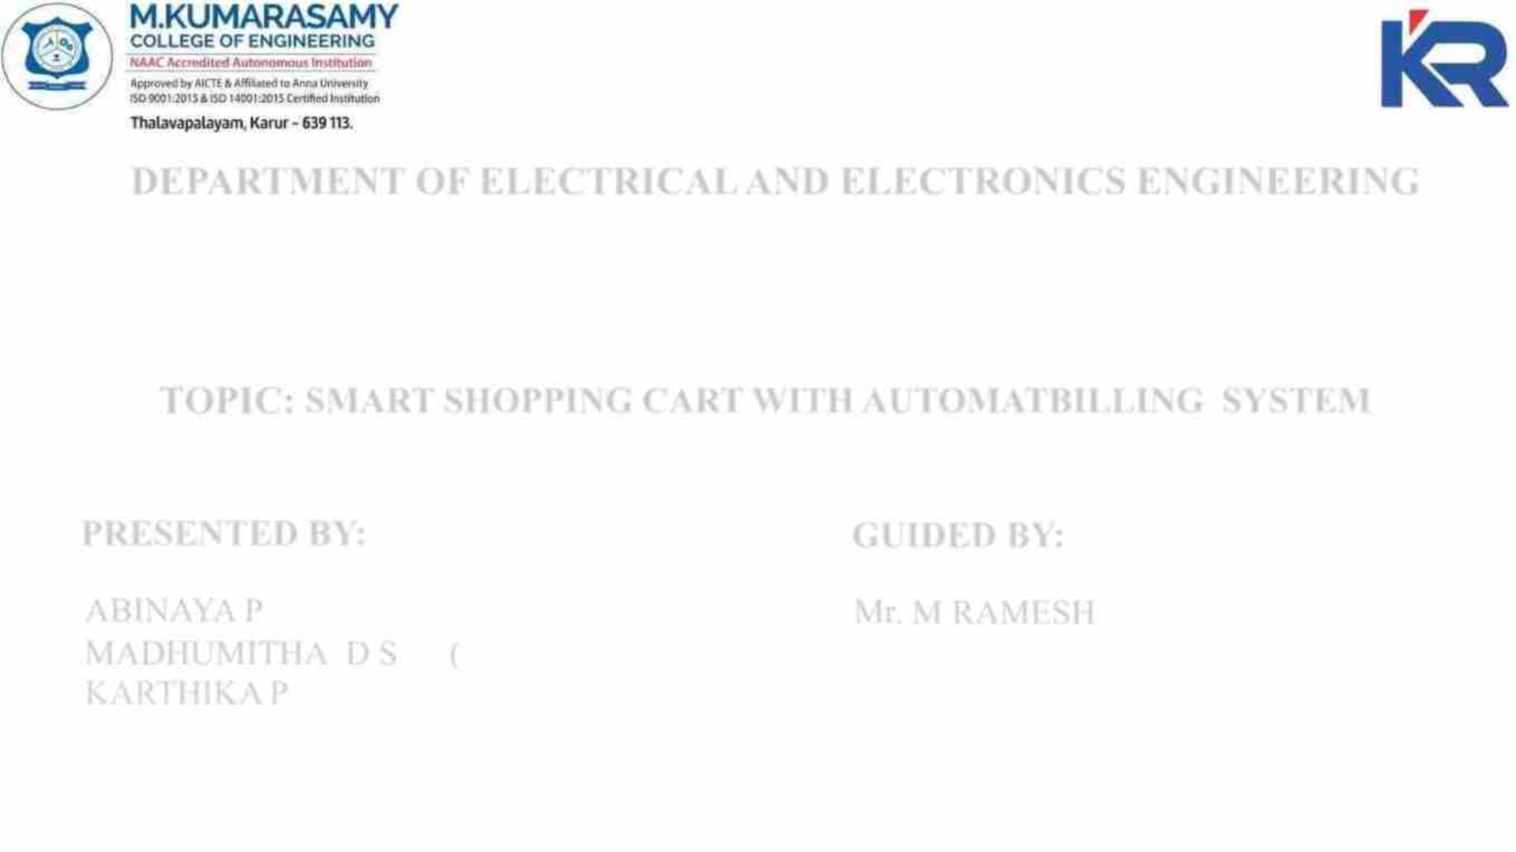
DEPARTMENT OF ELECTRICAL AND ELECTRONICS ENGINEERING
18EEP302L – MINOR PROJECT IV
Second Review Batch - 01
TOPIC: SMART SHOPPING CART WITH AUTOMATBILLING SYSTEM
PRESENTED BY:
GUIDED BY:
ABINAYA P
(20BEE4001)
Mr. M RAMESH,
MADHUMITHA D S (20BEE4044)
KARTHIKA P (20BEE4027)
Assistant Professor/EEE,
M Kumarasamy College Of Engineering,
Karur.
22-04-2023
18EEP302-Minor Project IV
1

Slide 2

Overview of Presentation
Abstract
Introduction
Literature survey
Existing Block Diagram
Proposed Block Diagram
Circuit Diagram
Components and its Specification
Hardware Setup
Conclusion
List of publication
21-04-2023
18EEP302L-Minor Project IV
2

Slide 3

Objective
The main objective of the project is to satisfy the customer and to reduce the time
spent on the billing process, which is to complete the billing process in the trolley
rather than waiting in a queue for one or two products.
The proposed system will give the customer a quick shopping experience by
generating automatic billing to avoid huge crowd or large queues in shopping
malls and super markets.
21-04-2023
18EEP302L-Minor Project IV
3

Slide 4

Abstract
In this project, we are proposing a new technique for shopping that is smart
shopping cart with automatic billing system using RFID technology and Arduino.
The main intention of our project is to gratify the consumers and to minimize the
time by doing the billing process in the trolley or cart.
Here, we will design a Shopping Cart with automatic billing system. To design
this project we need only a few electronic components, it is an added advantage to
this project.
Hence, it makes cost effective than other methods of technologies.
21-04-2023
18EEP302L-Minor Project IV
4

Slide 5

Abstract cont..,
To achieve this billing every product in Shopping centre should have the RFID tag,
and every trolley will have the EM 18 RFID Reader to scan the object.
When the object is scanned, then the object name and price will be automatically
sent and display in the LCD Display.
The LCD Display will also display the total amount of the purchased items. Thus,
the consumer can easily pay the total bill without waiting in the queue for long
period.
Keywords: Smart Shopping Cart, RFID Technology,Automatic Billing System,
EM 18 RFID Reader
21-04-2023
18EEP302L-Minor Project IV
5

Slide 6

Introduction
The modern technology has increased the standard of living for the humans.
A supermarket is a place where customers come to purchase their daily using
products and pay for them. So there is a need to calculate how many products are
sold and generate the bill for the customer.
When we go to a shopping cart for shopping, we have to seek for selecting the
right product. Also, after that, it is hectic to stand in line for billing all the
products. Hence, we are proposing to develop a smart shopping cart system that
will keep the track of purchased products for billing using RFID and Arduino.
21-04-2023
18EEP302L-Minor Project IV
6

Slide 7
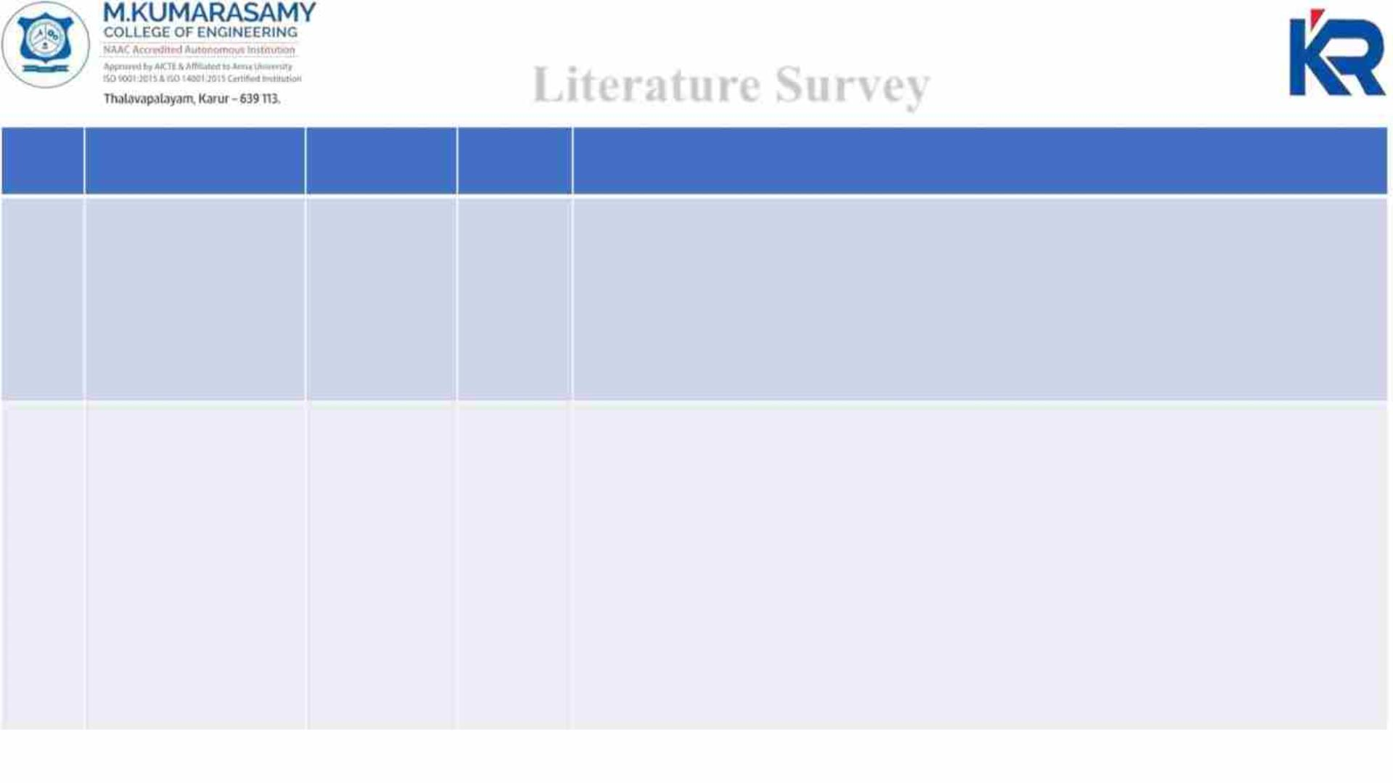
Literature Survey
S.NO
TITLE
AUTHOR YEAR
DESCRIPTION
01. SMART SHOPPING Mrs.K.Latha
CART USING RFID Sandhya U ,
May
2019
This paper presents about the proposed system, that will give the customer a quick
shopping experience by providing the product details on the customer’s smartphone
using machine learning algorithms, and will display total bill amount on the display
screen attached to the cart using RFID technology. RFID is used to identify each
product details not only by its type but also knowing its location. This will make sure
to the customer whether their shopping is under budget or not.
TECHNOLOGY
Gayathri L,
Vijayarani V,
Mr.Santhosh
kumar S
02. IMPLEMENTATIO Nilesh Unde,
Nov
2015
The system provides centralized and automated billing system that uses RFID and
Bluetooth communication modules. Each product of shopping mall will have a RFID
tag . Each shopping cart will be designed with a Product Identification Device (PID).
Information of the product that is to be purchased will be read through a RFID reader
on shopping cart, in the mean while that product’s information will be stored into
EEPROM which will be attached to the cart and that data will be send to Central
Billing System through the Bluetooth module. When the central billing system
receives the cart information and data stored in EEPROM, then the system will
access the product database and calculates the total amount to be paid for that
particular cart. Main aim of the project is to generate automatic billing to avoid huge
crowd or large queues in shopping malls and super markets.
N OF SMART
SHOPPING CART
USING RFID
Shankar
Shinde,
Abhishek
Thombare,
Satish
Suryawanshi,
Harshada
Mhaske
21-04-2023
18EEP302L-Minor Project IV
7

Slide 8
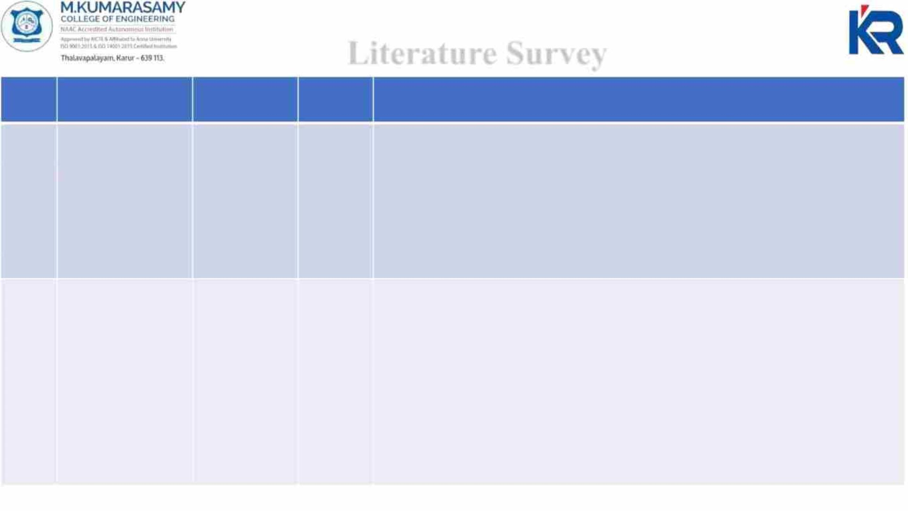
Literature Survey
S.NO
TITLE
AUTHOR YEAR
DESCRIPTION
03.
RFID BASED
SMART
TROLLEY
Mhamunkar,
Himanshu
Saroj,Prajakta
Katkar,Akansh
a Tiwari,
2019
This paper says presents, people buy a different product and deposit them in the
trolley. After total purchase one need to go to billing counter for the payment which
is very time consuming and at times very frustrating. So their main objective for
designing this prototype is to reduce the human efforts, eliminate the queue and also
eliminate the time taken during billing. Our prototype consist of components such as
RFID tags which is used for identification of the product, RFID reader which is used
for scanning of product when put in the trolley and it display in the LCD Display. So
at the billing counter the data is sent into the server.
Rahul Jena
04.
SMART
SHOPPING CART
USING RFID
Vaidhyanathan
RM ,Venkata
Krishnan,
Pradeep RajG,
Hemamalini S
04 Apr This paper targeted to minimize the Queue at a billing counter in a shopping mall.
2021
The customer can directly pay the amount either in-app or in the billing counter and
leave with the commodities he/she has bought. The hardware relies on Arduino Uno,
RFID Reader Module, RFID Card, and Buzzer. It eliminates the normal scanning of
products at the counter and in turn speeds up the entire process of shopping is easy
and also with this system, the customer shall know the total amount to be paid.
Hence the customer can plan his shopping only by buying the essential commodities
according to his savings. Since the entire process of billing is based on RFID, so it
reduces the possibility of human error substantially. The system also has a feature to
delete the scanned products by customers to further optimize the shopping
experience.
21-04-2023
18EEP302L-Minor Project IV
8

Slide 9
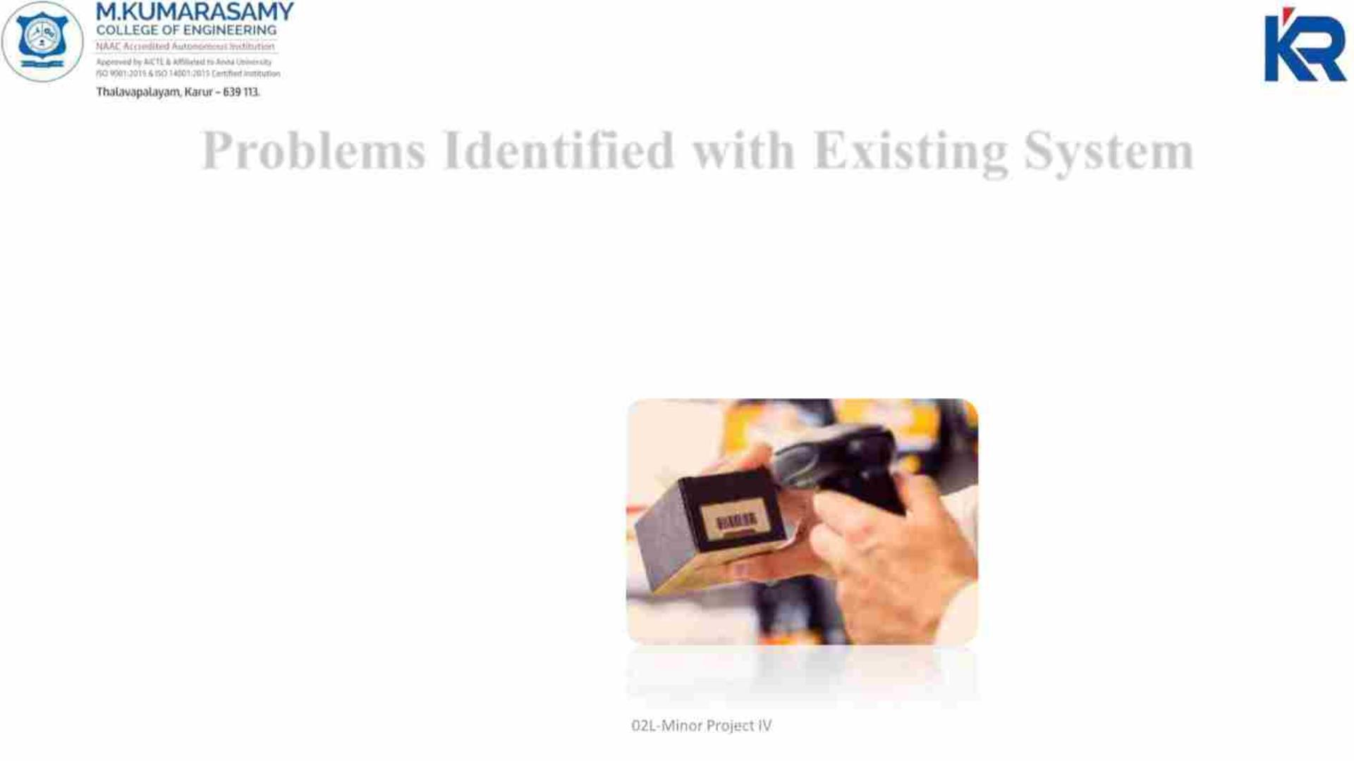
Problems Identified with Existing System
Barcodes are used in retail stores as part of the purchase process but Barcodes do
not have read/write capabilities. It requires optical line of sight (LOS) scanning. It
is labor intensive as it requires to be scanned individually. It is less secure compare
to RFID which can be easily forged. Scratched or crumpled barcodes may cause
problems while scanning.
21-04-2023
18EEP3
9

Slide 10
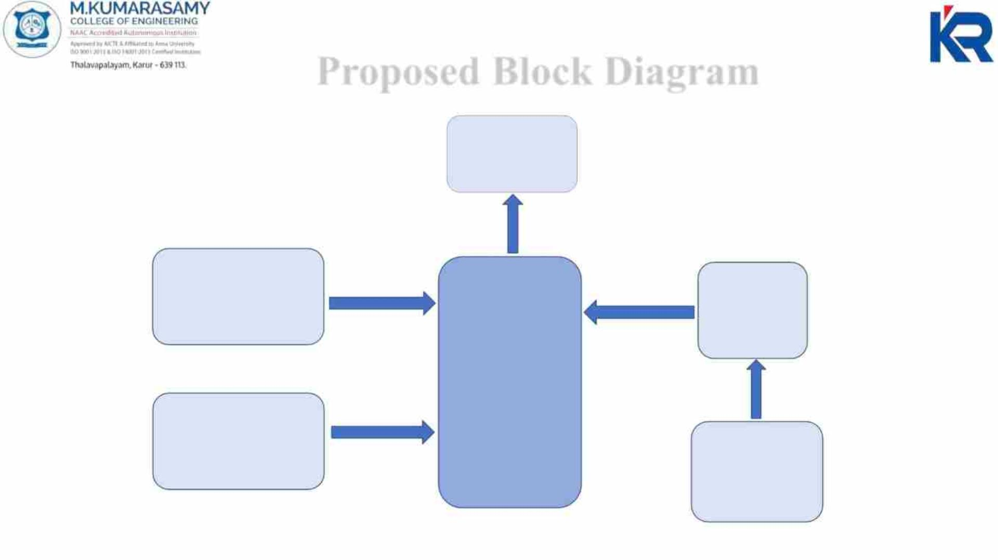
Proposed Block Diagram
LCD
DISPLAY
POWER SUPPLY
UNIT
USART
[SPI]
ARDUINO
UNO
DECREMENT
SWITCH
EM 18 RFID
READER
21-04-2023
10
18EEP302L-Minor Project IV

Slide 11
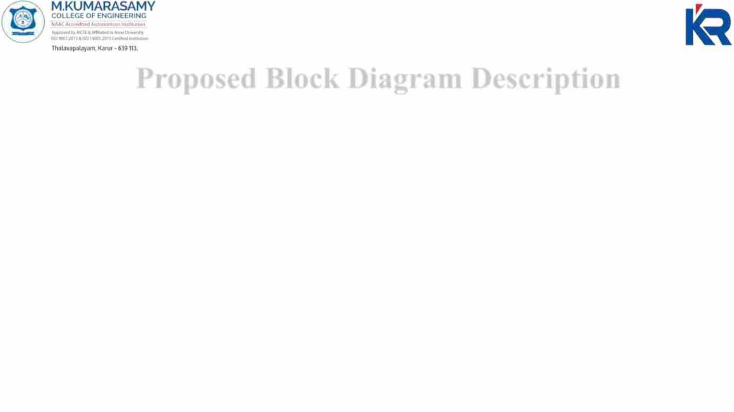
Proposed Block Diagram Description
Arduino is interfaced with all the remaining components. Once the microcontroller
is powered up with the use of a power supply, it is initialized and set to the basic
settings, now the system is ready to proceed which means the RFID card and the tag
can be scanned.
Then the RFID card or tag is scanned, the RFID reader fetches all the details from
the scanned card or tag, and if the scanning process is successful, the product details
will be transferred to the microcontroller memory and then it will be transferred to
the LCD module for display on the LCD screen.
21-04-2023
18EEP302L-Minor Project IV
11

Slide 12
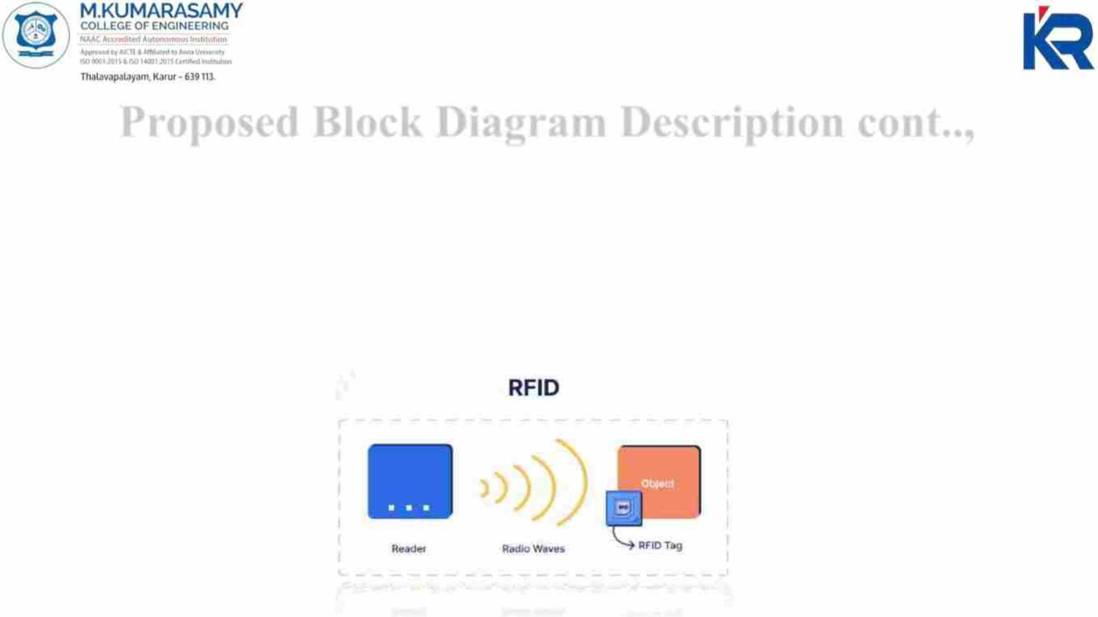
Proposed Block Diagram Description cont..,
Here the RFID module uses the SPI communication technique [USART] to transfer or
to retrieve the data from the RFID card or tag . After the shopping is completed the
entire bill details will be displayed on the LCD screen, each card or tag acts as a
product, where the product details are pre early set or dumped into the card.
The entire working process is implemented by the software called Arduino IDE. We
can also check with the Proteus simulation software before the hardware
implementations.
21-04-2023
18EEP302L-Minor Project IV
12

Slide 13
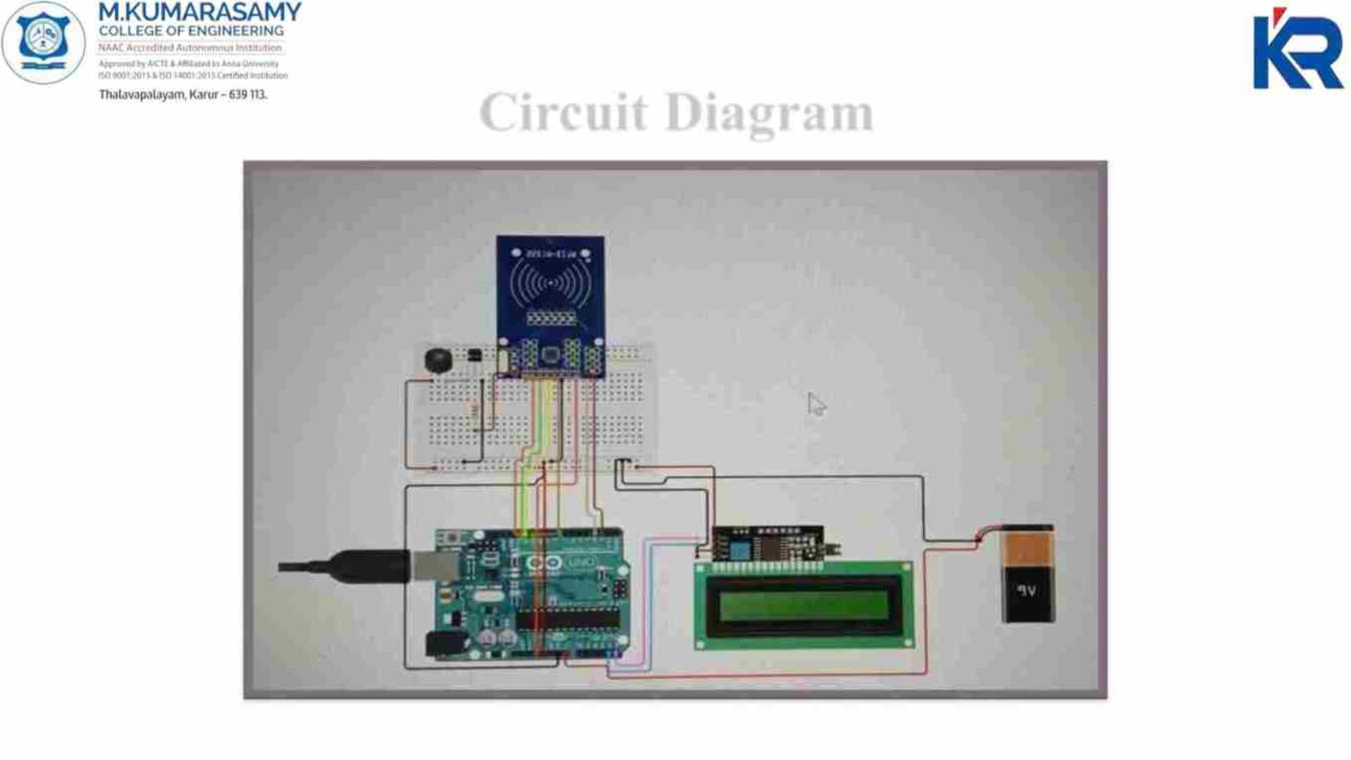
Circuit Diagram
21-04-2023
18EEP302L-Minor Project IV
13

Slide 14
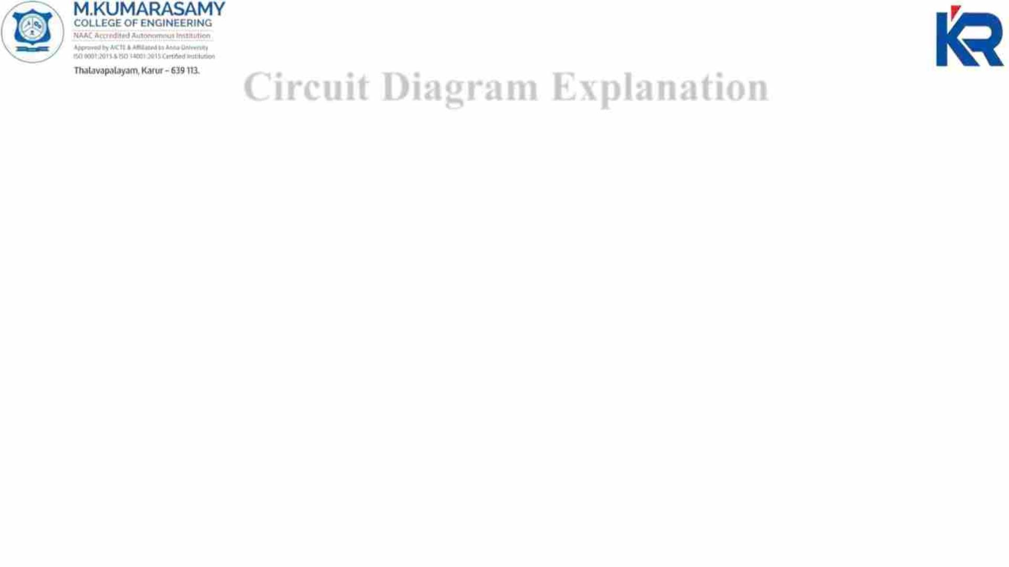
Circuit Diagram Explanation
The power supply is given to microcontroller board (UNO) through rectifying unit
and transformer which converts the incoming ac to dc and it is desirable for all
components to get initialized for working.
From Arduino UNO, LCD Display (16x2) and the EM-18 RFID Reader Module
are connected, the EM-18 Reader will be used to scan the products with RFID
cards.
After scanning, the data will be send to microcontroller, then it reaches LCD
Display which will display the price details and the product name.
This is the simple connection of our project which makes easier and simpler to
implement in carts of all shopping malls and super markets.
21-04-2023
18EEP302L-Minor Project IV
14

Slide 15
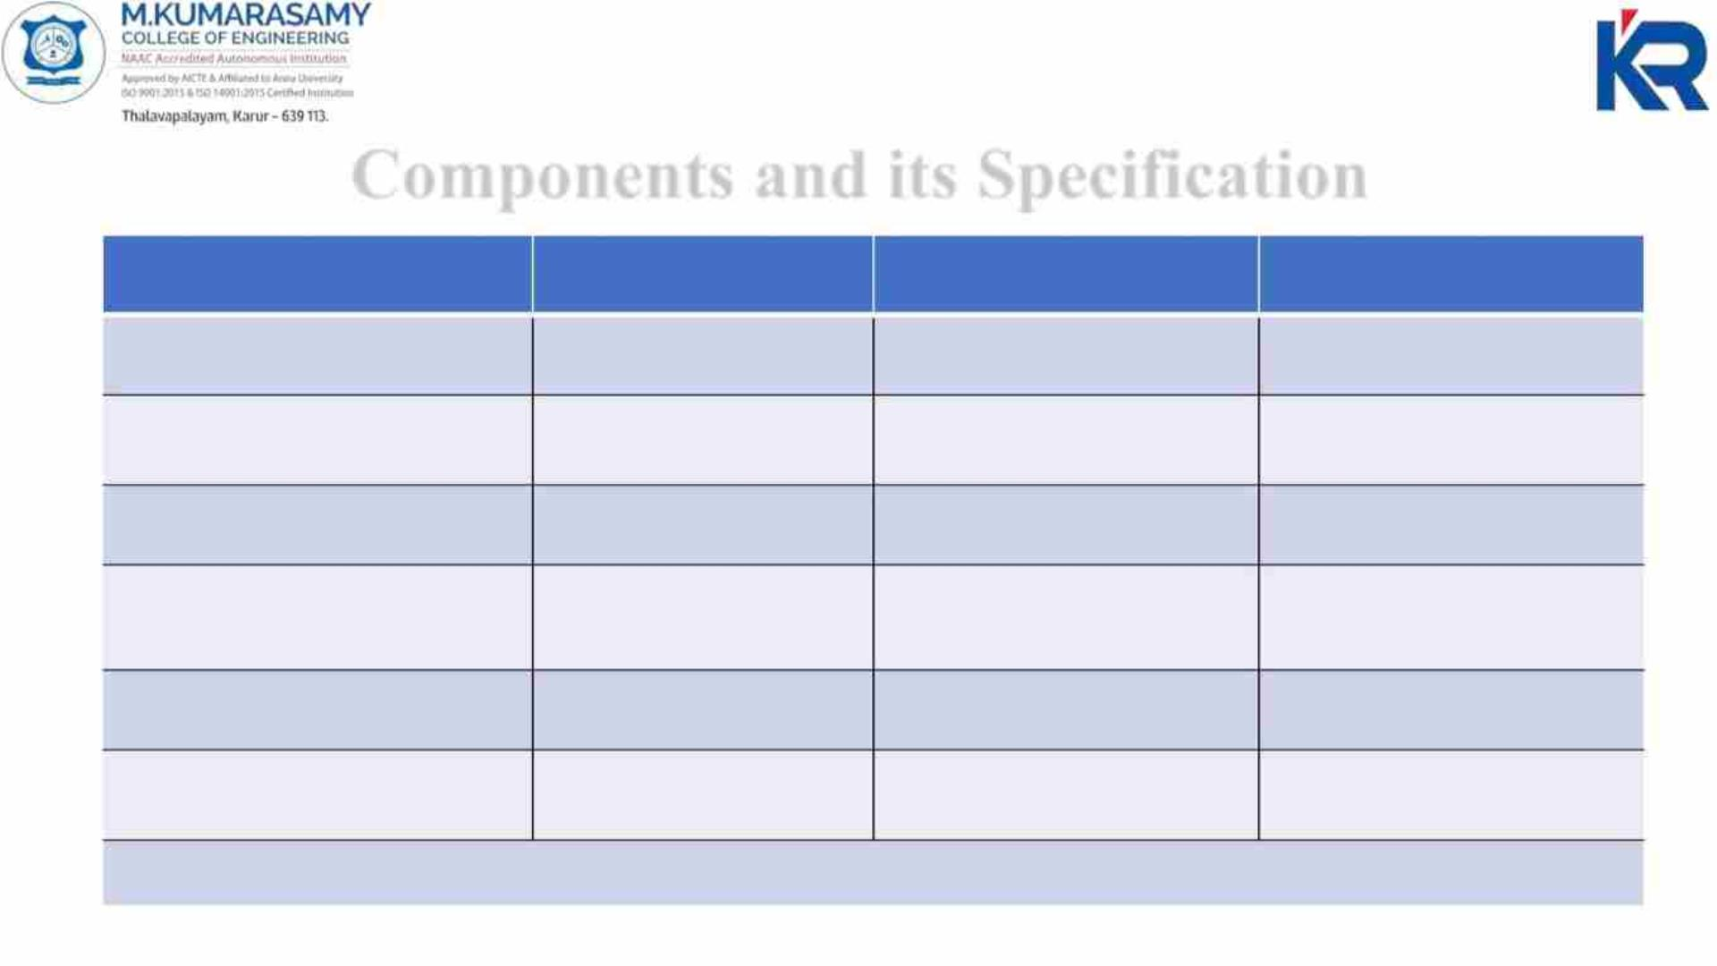
Components and its Specification
Components
Specification
UNO
Quantity
Price(₹)
Arduino
1
1
1
800
Transformer with full bridge
rectifier
230V to 12V
16x2 LCD I2C
580
LCD Display
250
450
RFID Reader Module
EM-18
1
RFID Reader cards
Push Button Switch
Plastic thin card
3
1
135
80
MAX 50mA 24 DC
TOTAL =2295
21-04-2023
18EEP302L-Minor Project IV
15

Slide 16
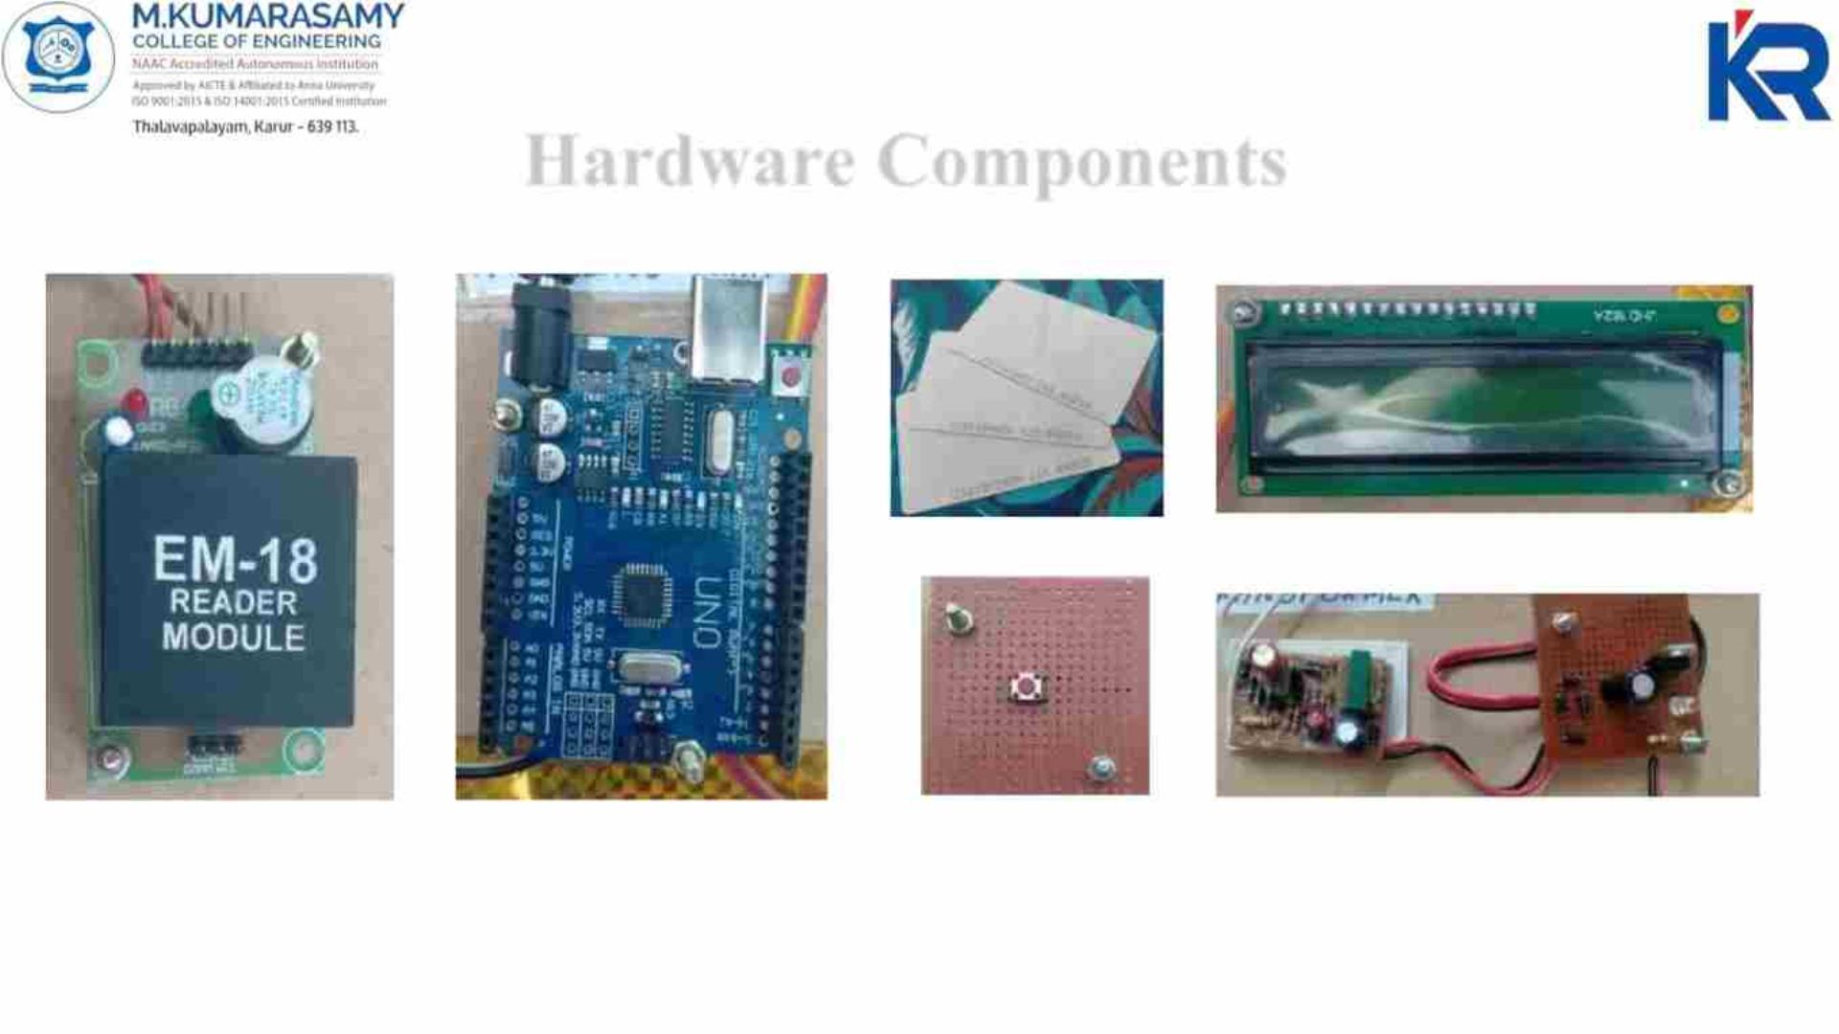
Hardware Components
RFID CARDS
LCD DISPLAY 16x2
EM-18 READER
MODULE
ARDUINO
UNO
PUSH BUTTON
SWITCH
RECTIFYING UNIT
WITH TRANSFORMER
21-04-2023
18EEP302L-Minor Project IV
16

Slide 17
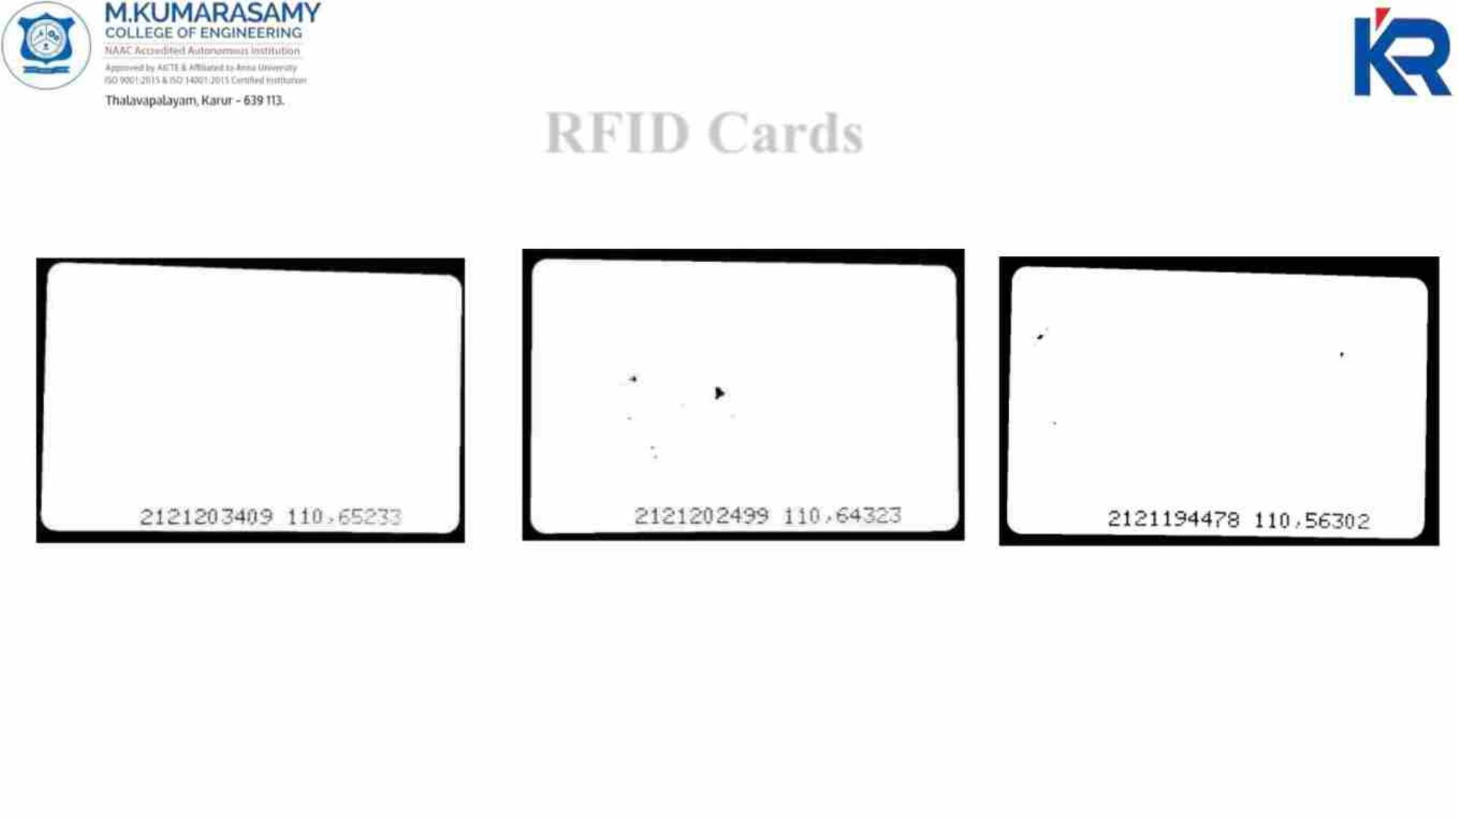
RFID Cards
5 STAR Rs.20
PARLE-G Rs.15
BUTTER Rs.30
21-04-2023
18EEP302L-Minor Project IV
17

Slide 18
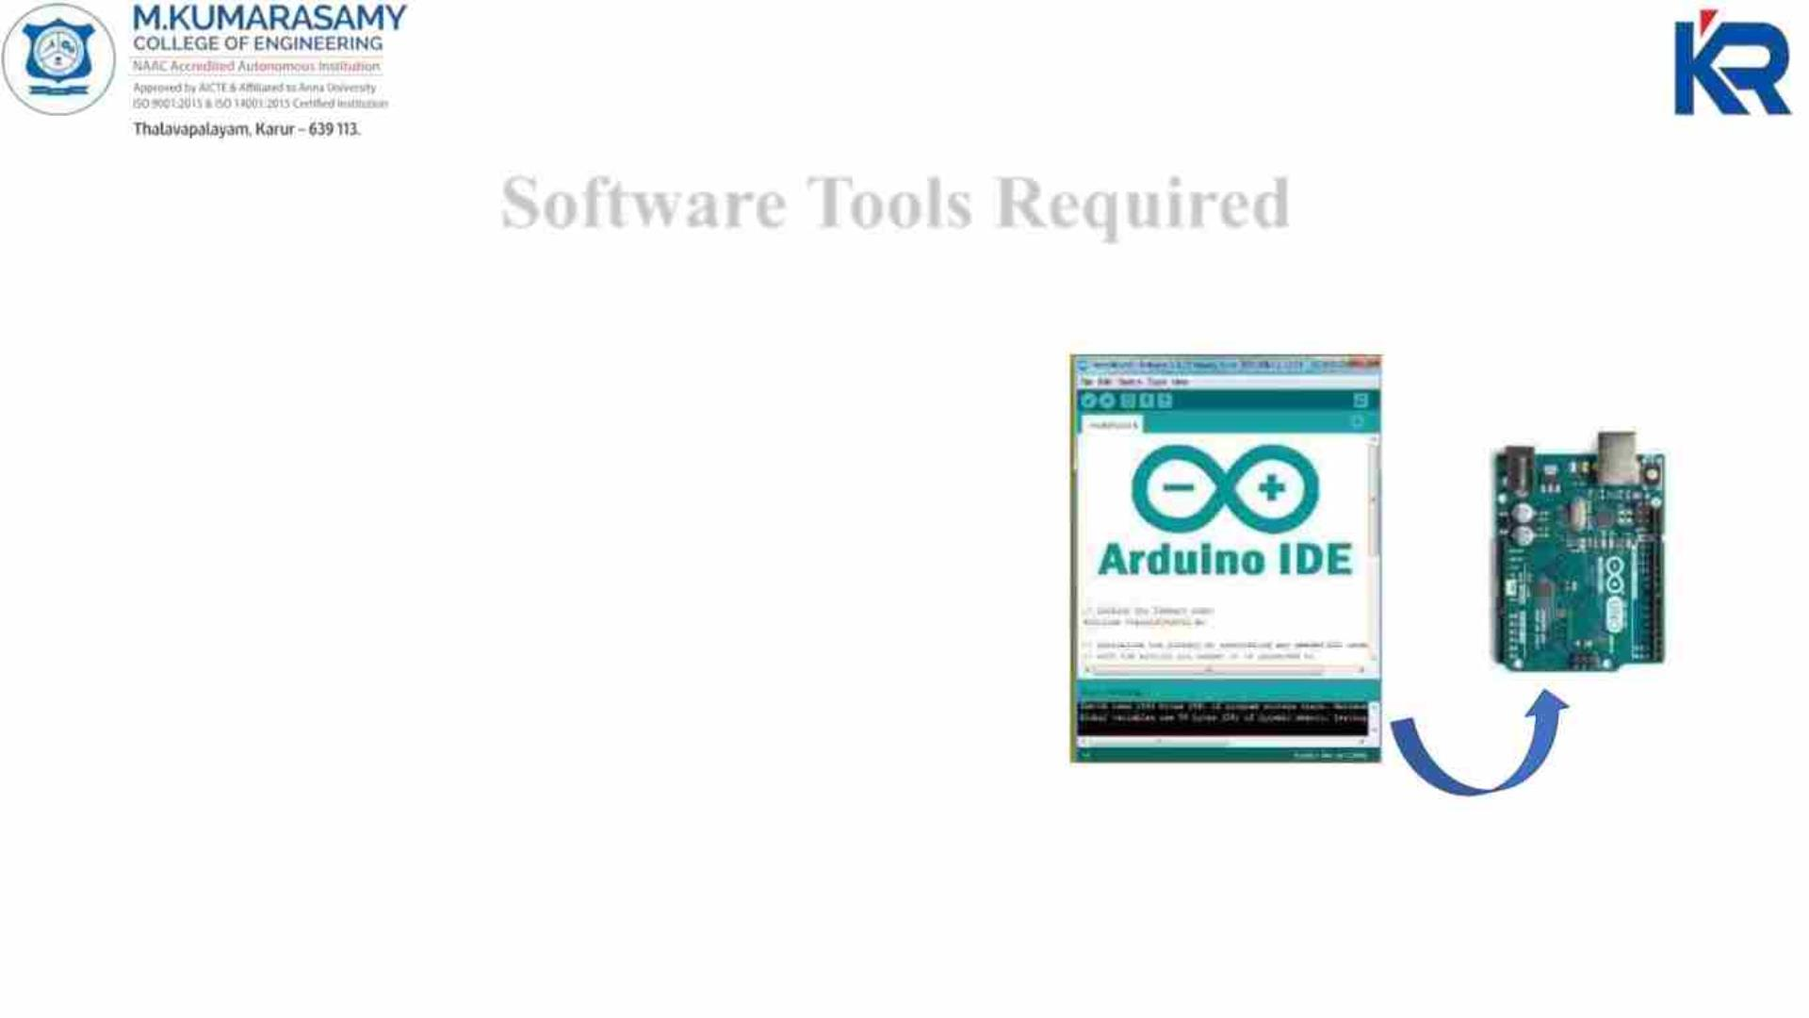
Software Tools Required
Programming Language :Embedded C
Arduino IDE
To upload the program code from
Arduino IDE software to Arduino UNO
21-04-2023
18EEP302L-Minor Project IV
18

Slide 19
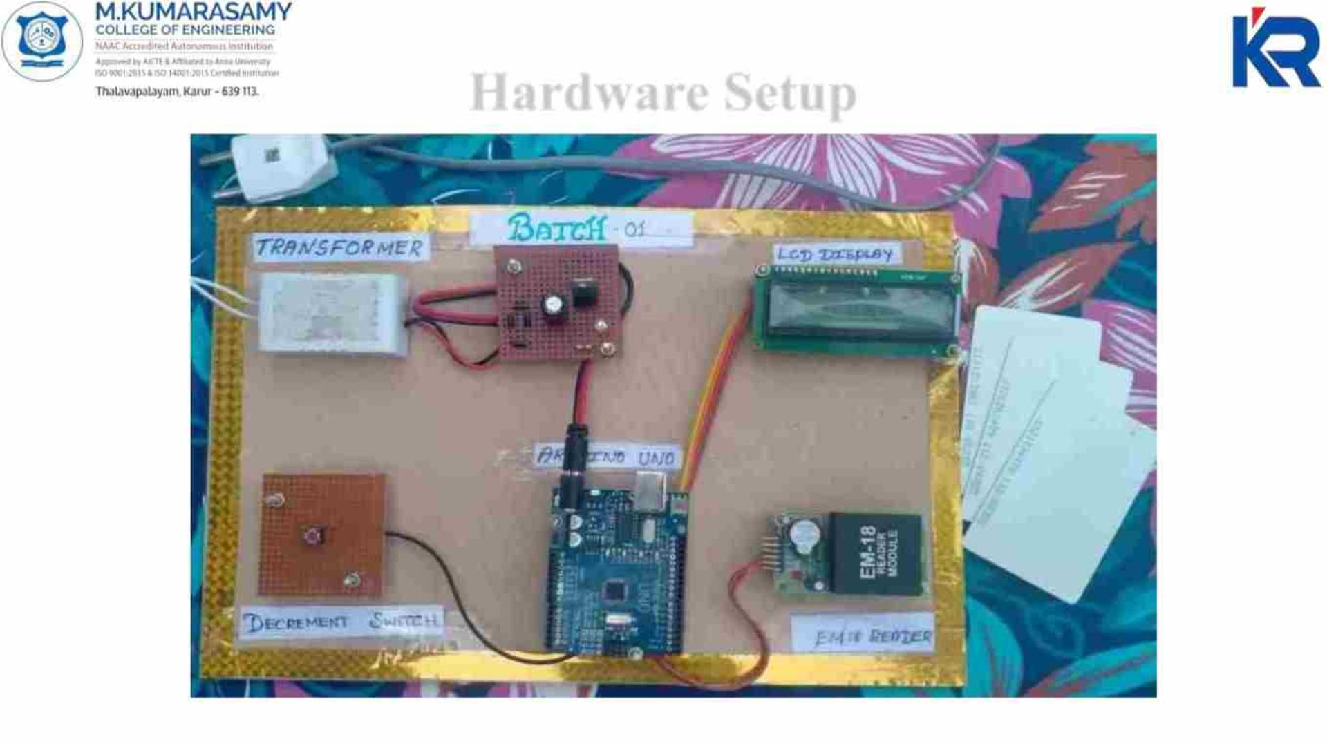
Hardware Setup
21-04-2023
18EEP302L-Minor Project IV
19

Slide 20
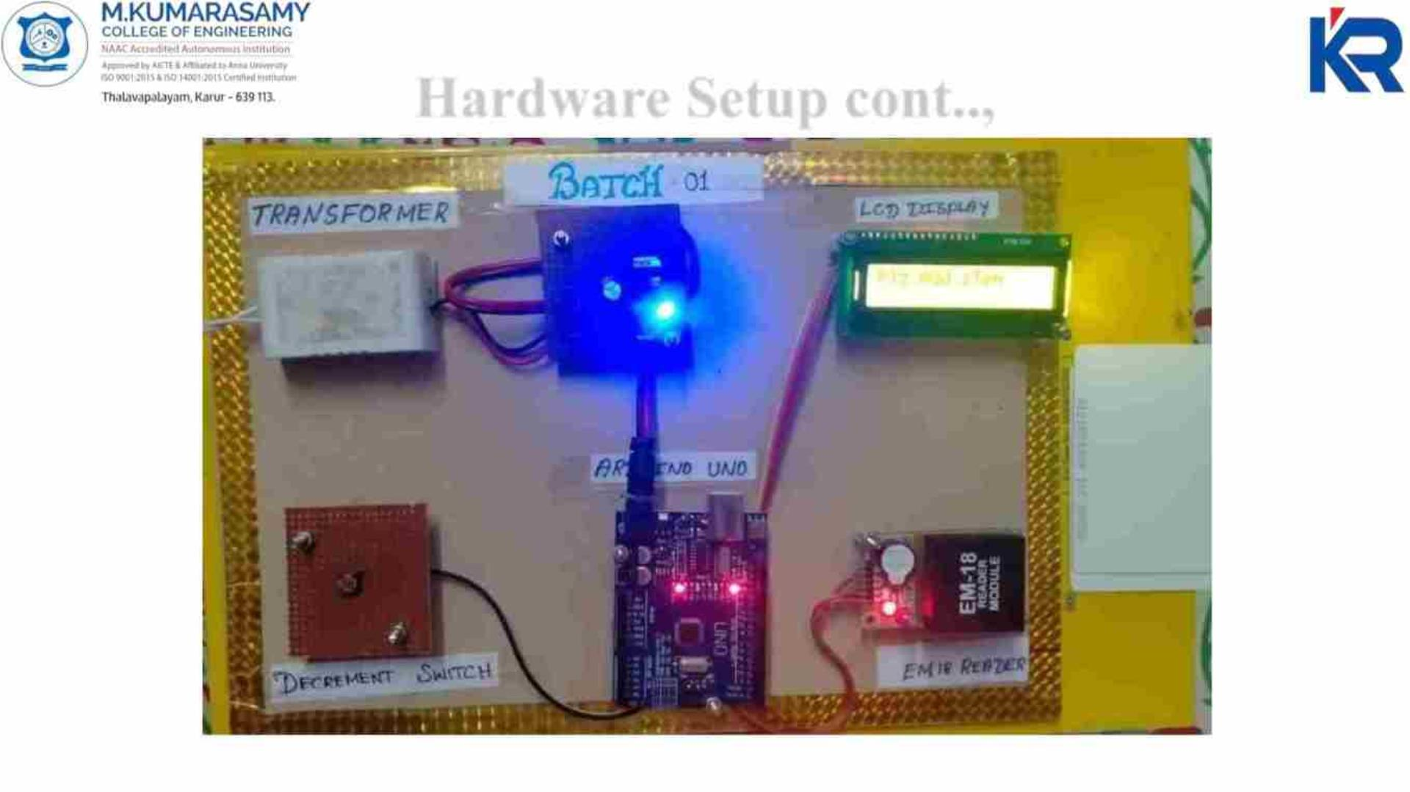
Hardware Setup cont..,
21-04-2023
18EEP302L-Minor Project IV
20

Slide 21
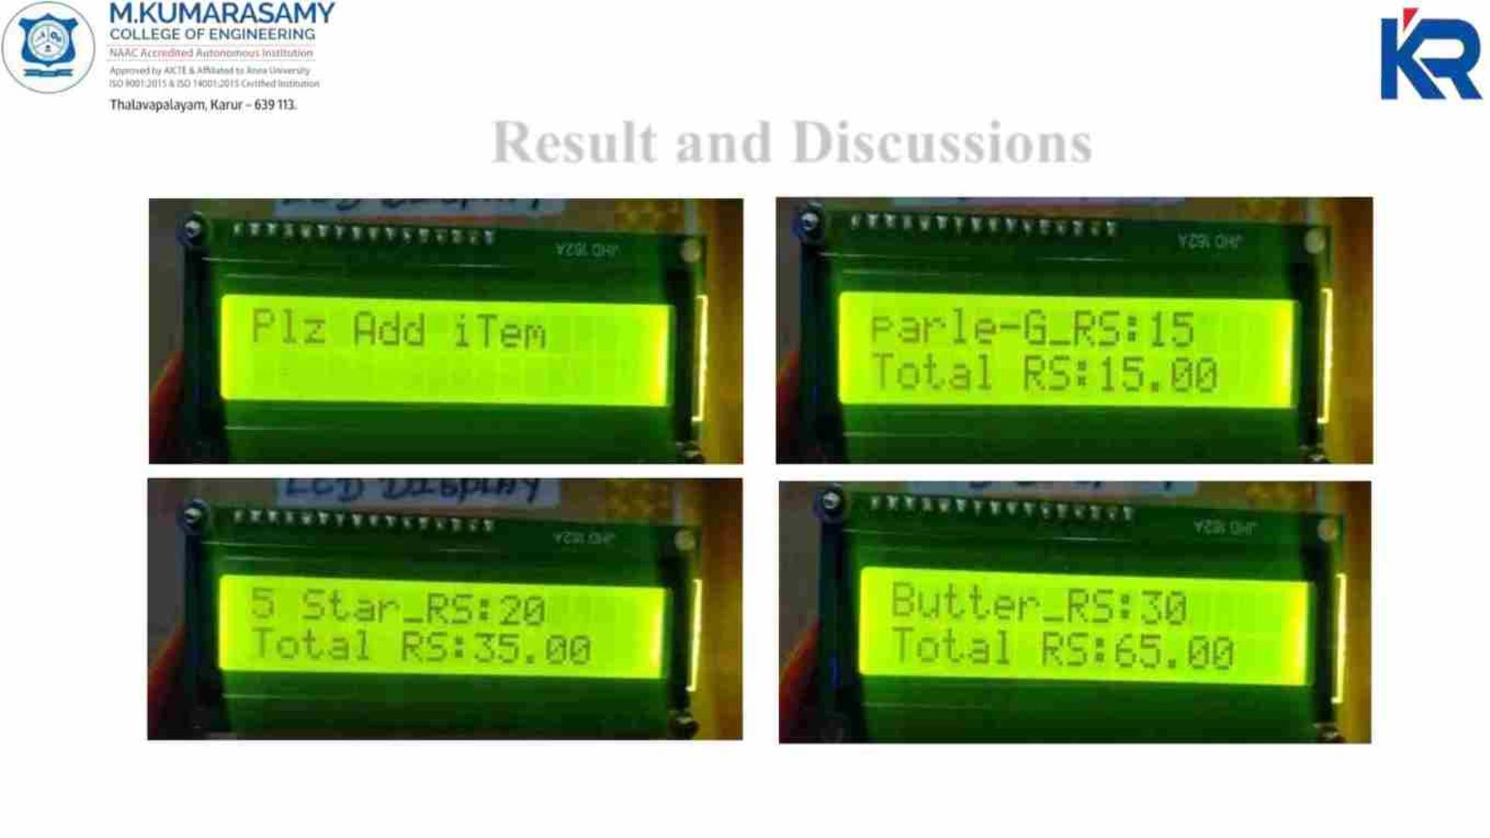
Result and Discussions
21-04-2023
18EEP302L-Minor Project IV
21

Slide 22

Result and Discussions cont..,
The figures shown in before slides represents the output of our project;
The first image shows the “plz add item”, it will be displayed until we add any
items or products in the cart.
Once we started to scan our products, it will display the product name, its price
and the total price.
From image 2,3 and 4, we can infer that Parle-G, 5 star and Butter are scanned
respectively, then their prices are added. Finally it displays the total price to be
paid.
21-04-2023
18EEP302L-Minor Project IV
22

Slide 23
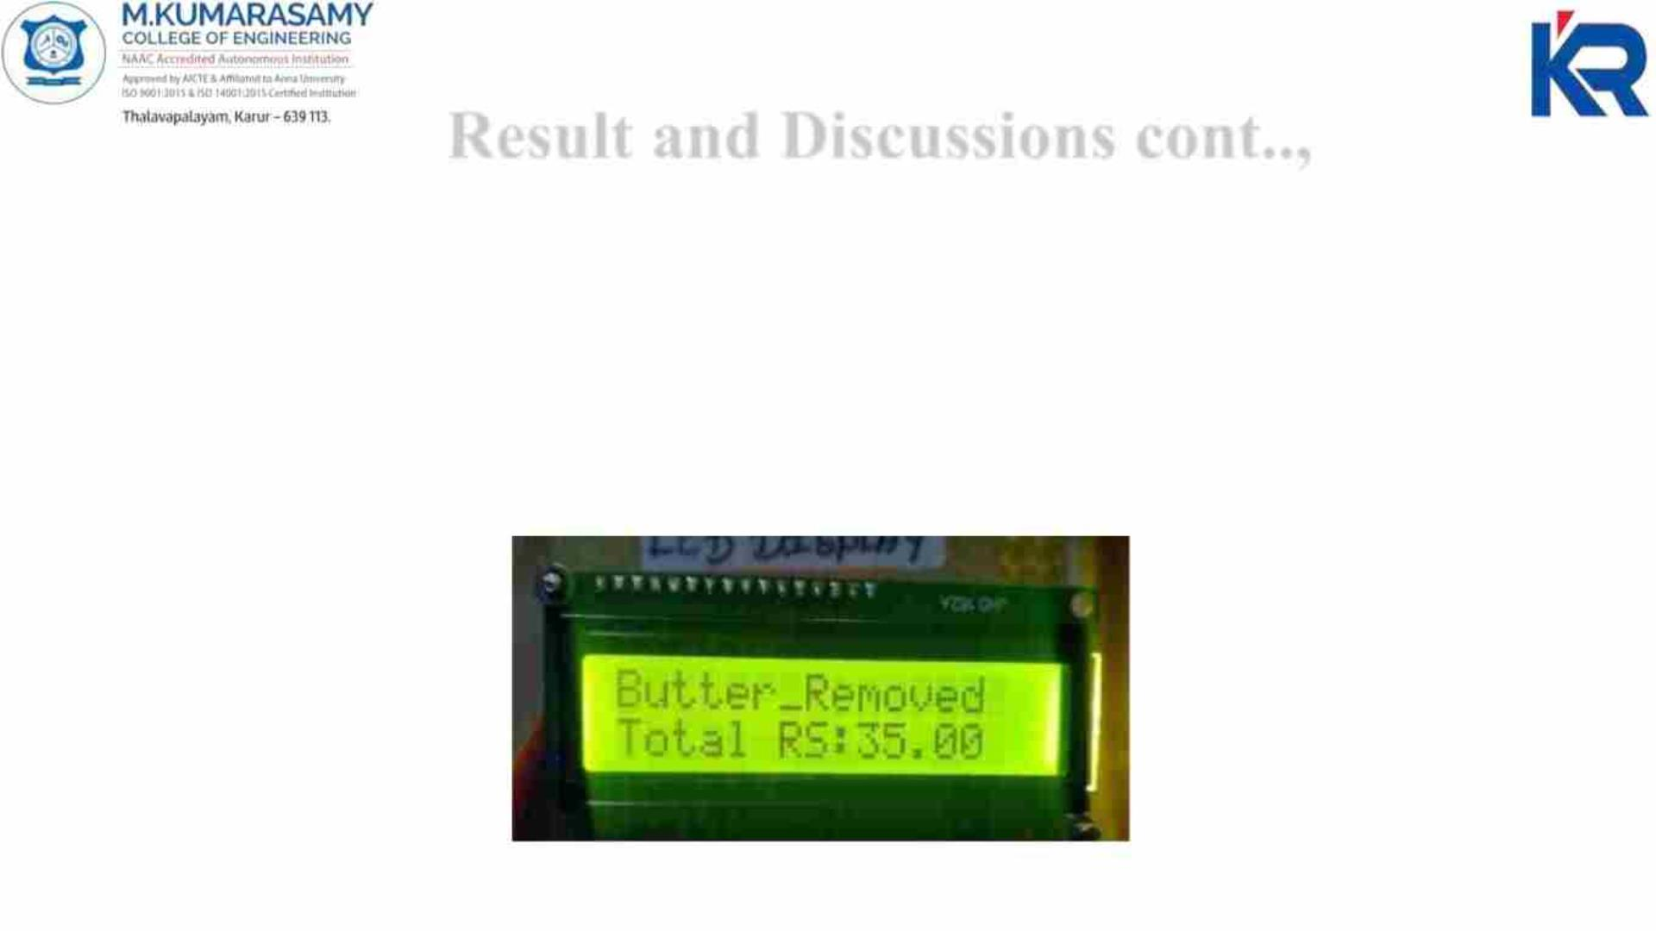
Result and Discussions cont..,
Decrement process:
When we want to remove the product which was mistakenly taken by the
consumer, press the decrement push button and scan the mistaken product
simultaneously, then the product’s price will be decremented in the total price.
21-04-2023
18EEP302L-Minor Project IV
23

Slide 24
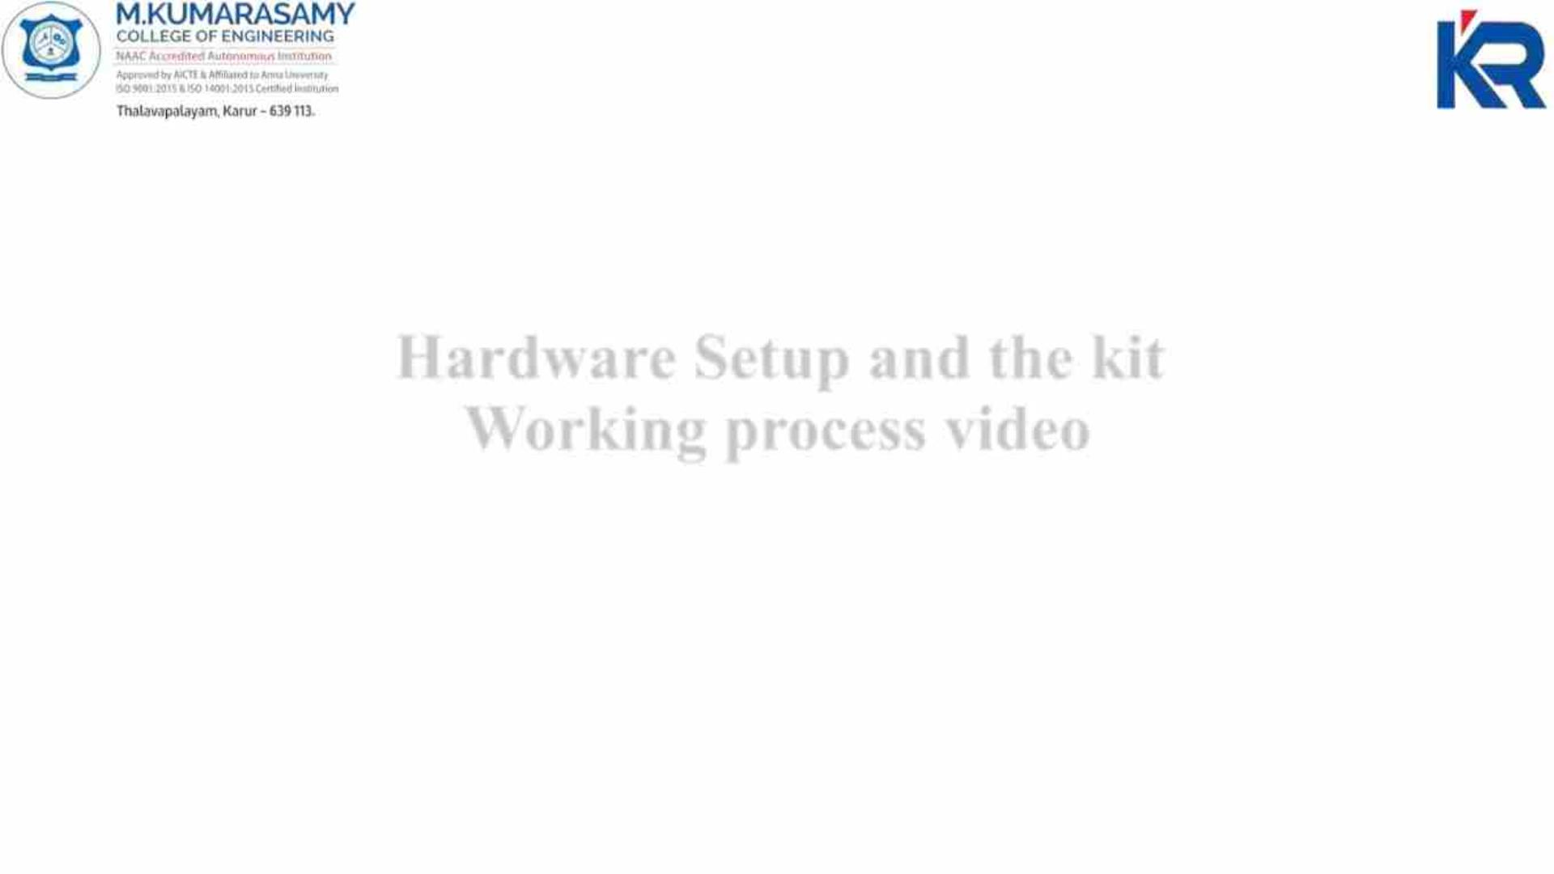
Hardware Setup and the kit
Working process video
21-04-2023
18EEP302L-Minor Project IV
24

Slide 25
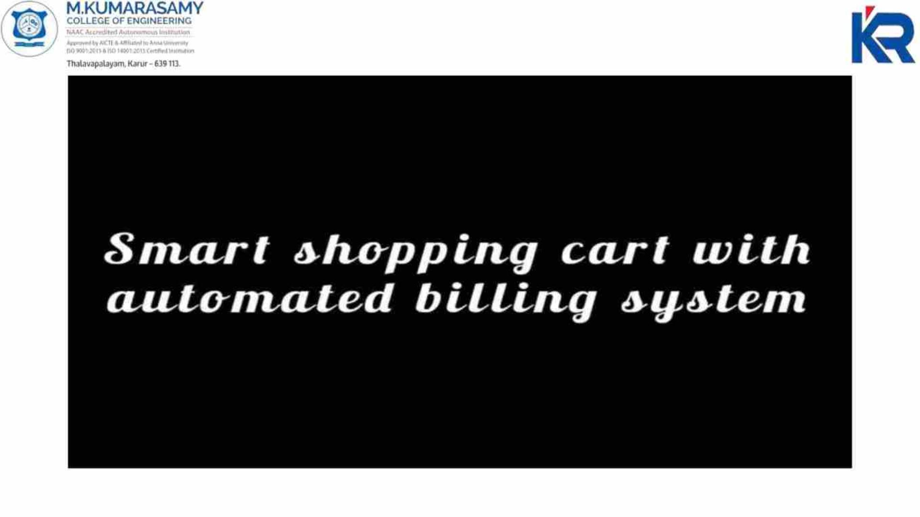
21-04-2023
18EEP302L-Minor Project IV
25

Slide 26

Conclusion
The progression in science & technology development is an unstoppable process.
Now & then evolution changing technologies are being invented.
This innovative project idea can be used in places like shopping complexes,
supermarkets & malls to purchase the products.
Hence this project will help in improving the security & also the shopping time
can be reduced.
It also provides an enjoyable & user- friendly shopping experience to the
customers.
21-04-2023
18EEP302L-Minor Project IV
26

Slide 27

Future Scope
Development of this project can be done in many ways, where RFID tags can be
replaced by RFID stickers which are small in size and low cost.
Security can be improved by counting the number of items or placing weight
sensors within the cart for tallying the weight and getting all the types of product
names when cart is passed through a particular aisle using camera module.
Multiple RFID tags can be read using a single RFID reader for more number of
products which are added in the cart.
21-04-2023
18EEP302L-Minor Project IV
27

Slide 28
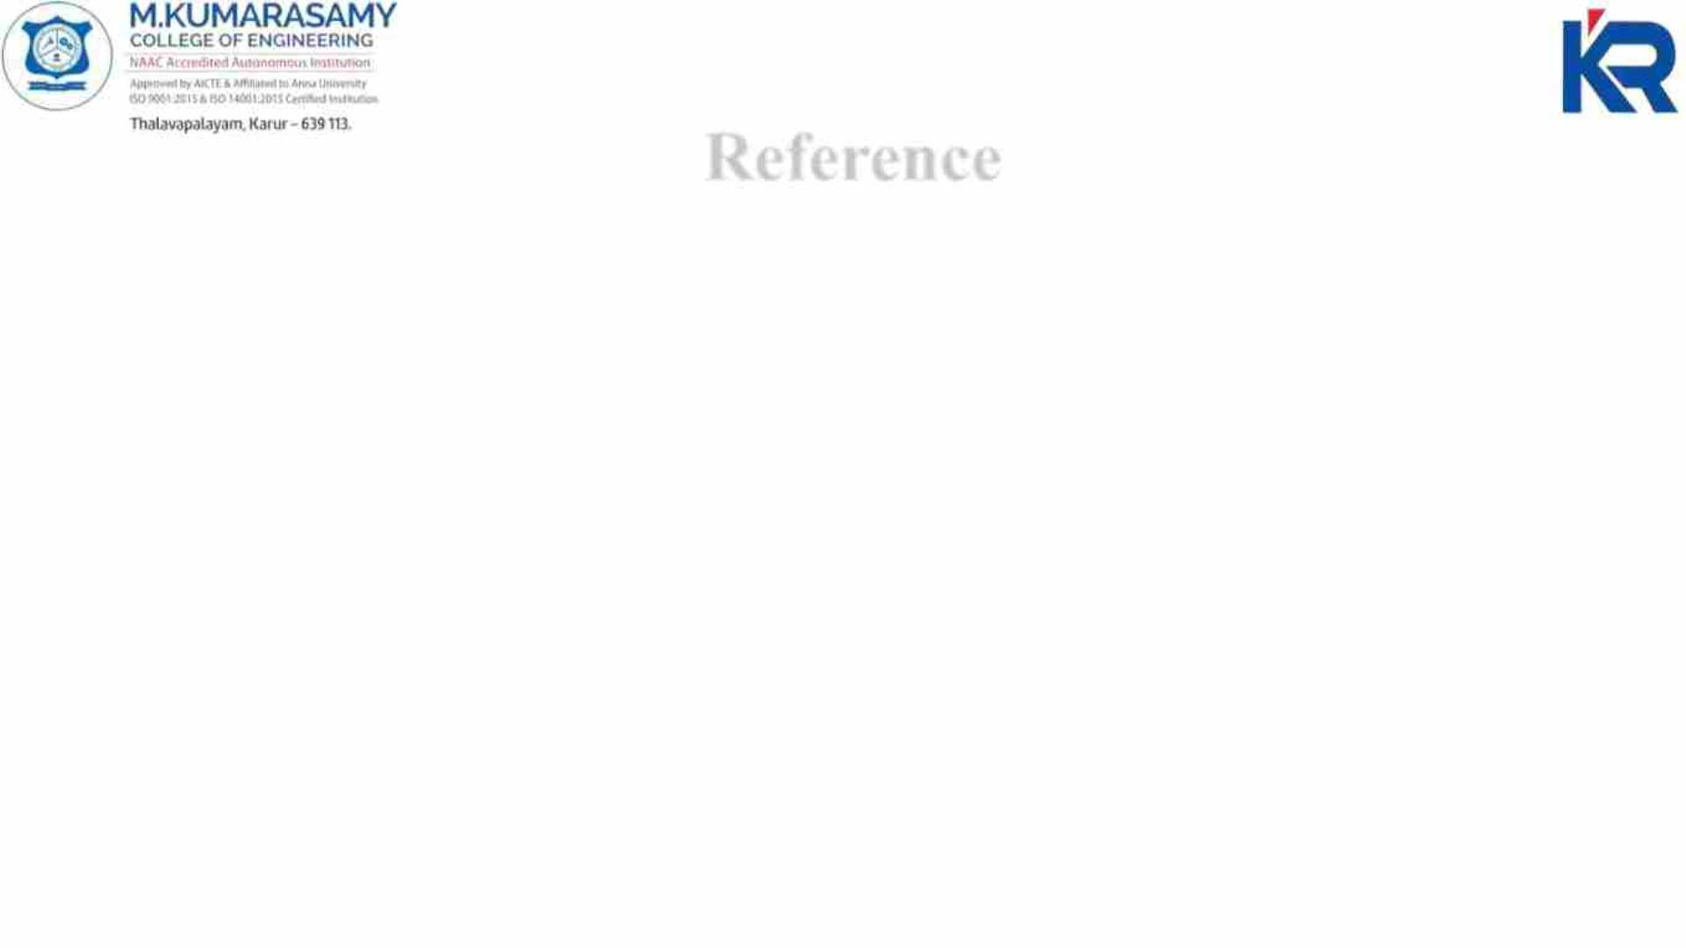
Reference
https://how2electronics.com/smart-shopping-cart-with-automatic-billing-system-
using-rfid-arduino/
https://ijrti.org/papers/IJRTI1904010.pdf
https://www.youtube.com/watch?v=q7dgn4fesR8&ab_channel=svsembedded
https://www.ijert.org/smart-shopping-cart-with-automated-billing-system
21-04-2023
18EEP302L-Minor Project IV
28

Slide 29

List of Publications
Mr M.RAMESH, P.ABINAYA,P.KARTHIKA, D.S.MADHUMITHA of M.
Kumarasamy College of Engineering presented the paper entitled “SMART
SHOPPING CART WITH AUTOMATED BILLING SYSTEM” in the International
Conference on Recent Advancements in Engineering and Technology (ICRAET'23)
held at M.KUMARASAMY COLLEGE OF ENGINEERING, Karur, Tamil Nadu, India
during 31st March 2023.
21-04-2023
18EEP302L-Minor Project IV
29

Slide 30
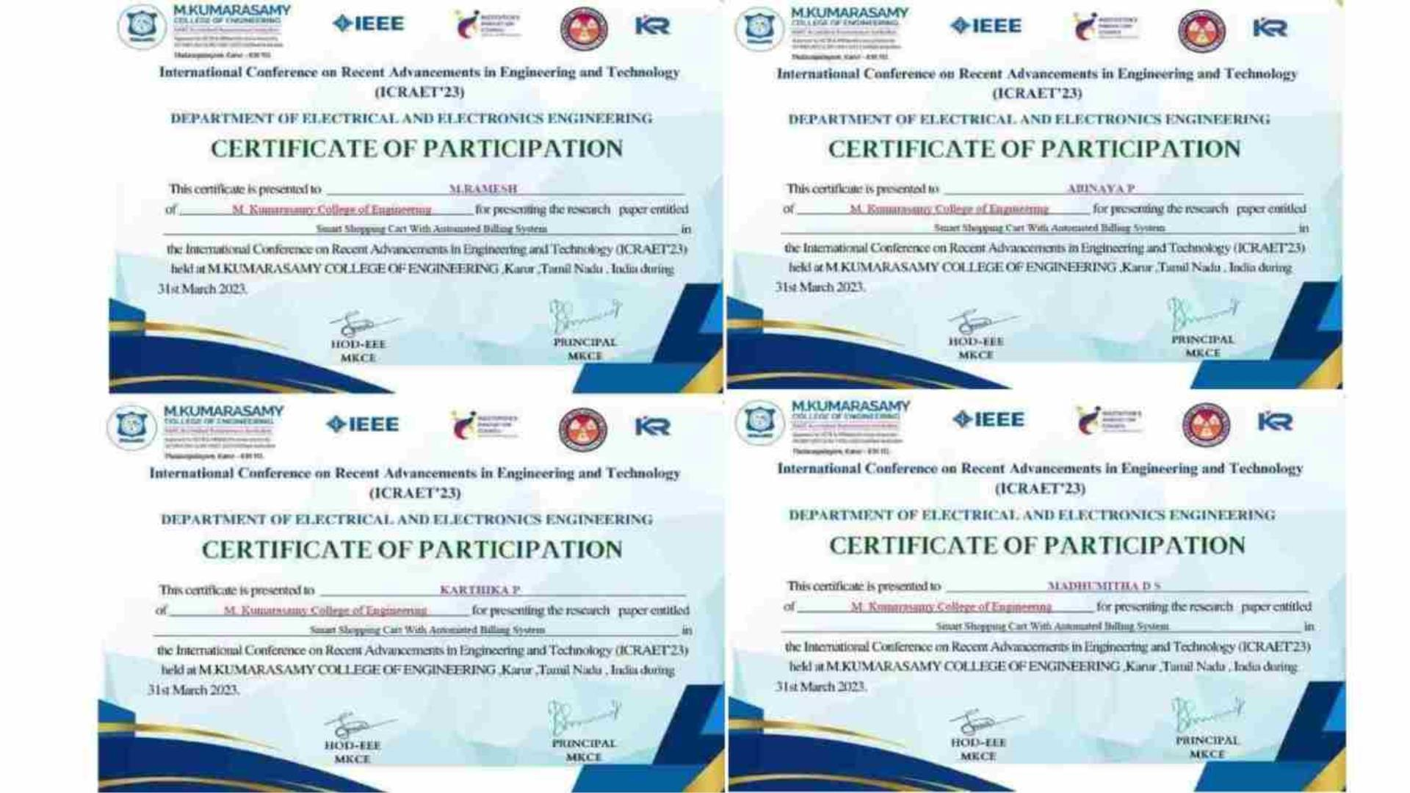

Slide 31
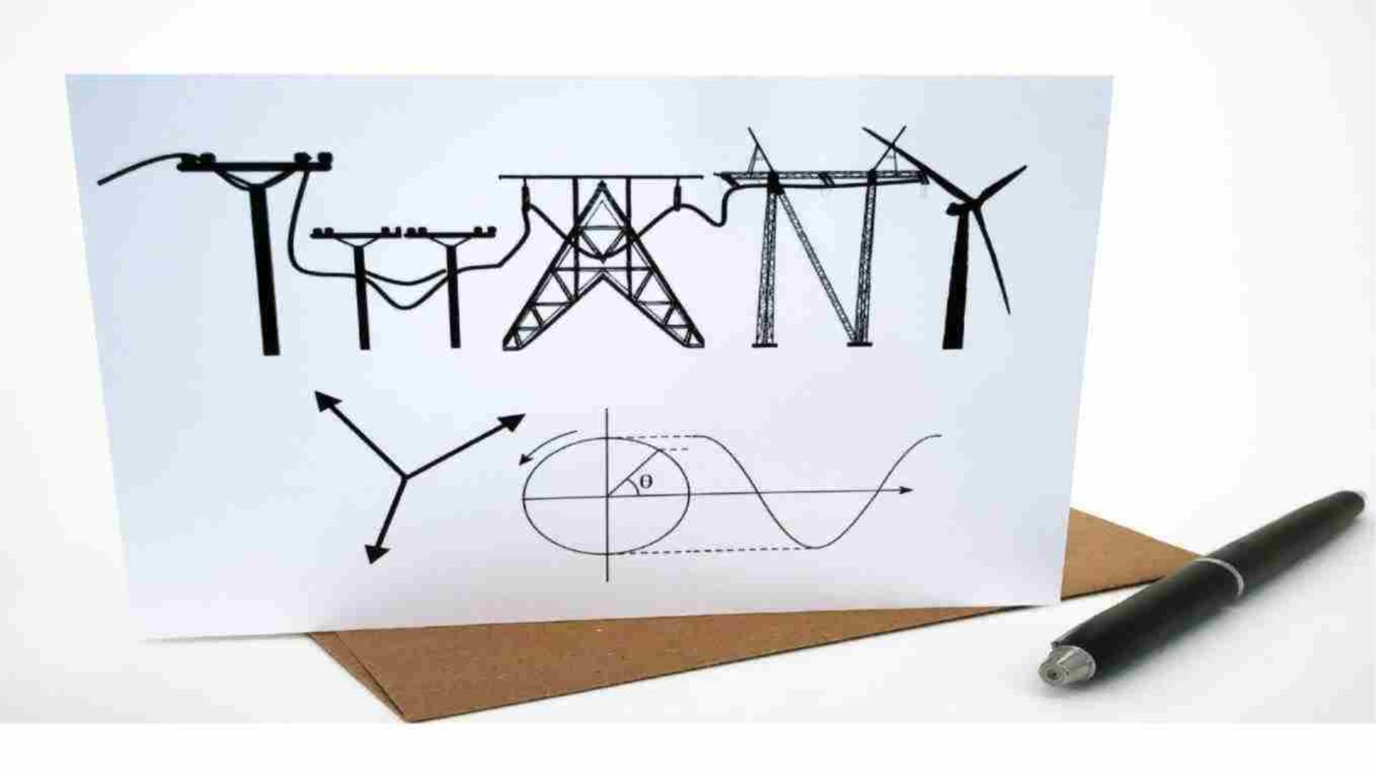
21-04-2023
18EEP302L-Minor Project IV
31

